Slide 1
Genomic Insights into
ATF3 Regulation of cell proliferation of HepG2 cells
Rameesha Syed, Chandrima Modak, Sahiti Somalraju

Slide 2
Introduction

Slide 3
Background: ATF3
AMP-dependent transcription factor (ATF-3) protein is a stress-induced transcription factor: vital roles in modulating metabolism, immunity, and oncogenesis.
ATF3 acts as a hub of the cellular adaptive-response network.
Member ATF/cAMP response element-binding (CREB) family.
Notes:
Atf3 protein is a transcription factor induced by cellular stress plays a vital in modulating metabolism, immunity and tumor progression. Atf3 belongs to the ATF/cAMP response element-binding family known as the CREB family. This family of protein are associated with regulating transcription activity of different transcription factors and growth factors. In the literature atf3 has been regarded as master regulator in metabolic homeostasis as it acts as a hub of cellular adaptive-response network.

Slide 4
Project Objectives
Earlier studies have shown that overexpression of ATF3 protein decreases cell proliferation, cell migration and cell growth in HepG2 cells (liver tumor cells).
Our study aims to use ChIP-seq data to identify the genomic regions that AFT3 protein binds to in the DNA to facilitate HepG2 cells suppression.
Notes:
Our interest in learning about atf3 and its role in hepatocarcinoma stems previous findings by Li et.al., on overexpression of atf3 induced decreased cell proliferation, cell migration and cell growth in hepatocarcinoma cell HCC line HepG2. In our study we aimed to identify the genomic regions where atf3 protein binds to in the dna to facilitate tumor suppression in hepato cells.

Slide 5
The Dataset
Data for treatment and control groups were extracted from ENCODE databases with IDs:
Treatment: ENCFF522PUA, ENCFF094LXX
Control: ENCFF522PUA, ENCFF094LXX
HepG2 Cell line was used for our samples.
Each read size was 50 bp long and was sequenced using Illumina HiSeq 2000
Notes:
We start our study by extracting data from ENCODE database. This Chip-seq data extracted were targeted for ATF3 and extracted from HepG2 cell lines using illumina hiseq-2000 machine. Each read were 50 base pair long.

Slide 6
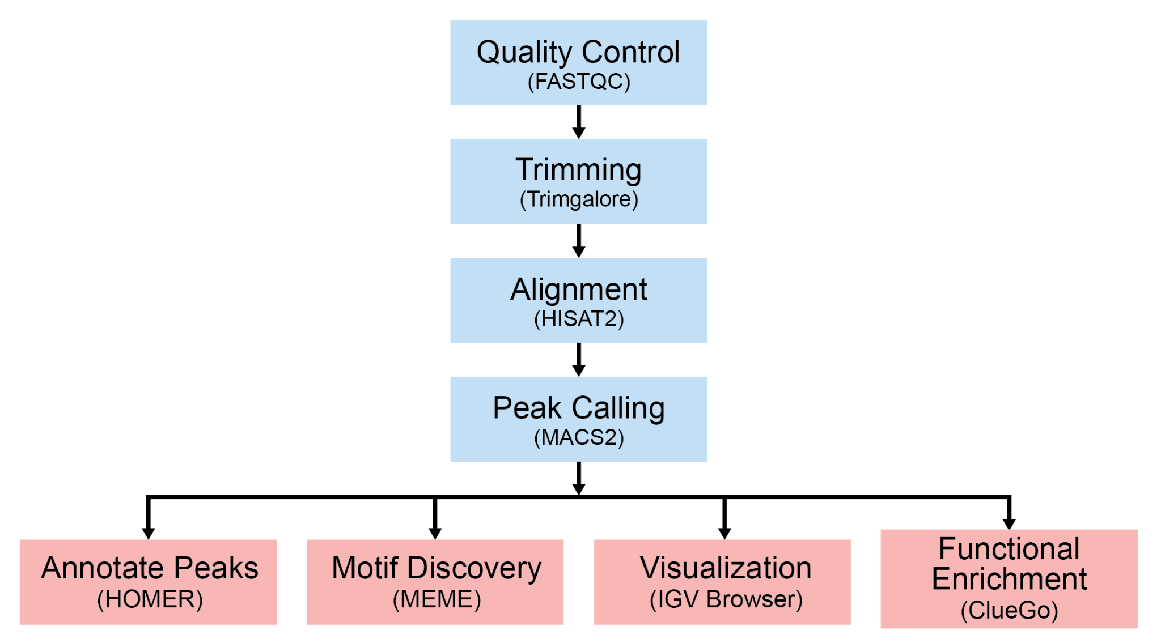
Pipeline

Slide 7
Results

Slide 8
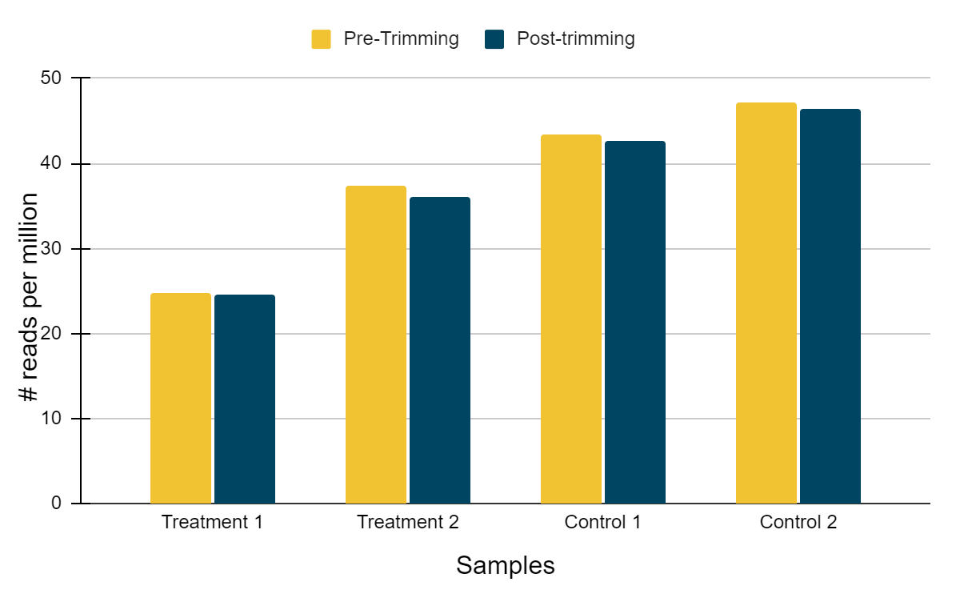
Quality Control and Trimming
FastQC and Trim Galore were used for reads quality analysis.
Processing of the reads based on phred33 score of each nucleotide.
Any overrepresented sequence were remove for downstream analysis.
Fig: Read counts report pre-QC and post-QC for both the group. Blue are the treatment group and Oranges are control
Notes:
For Quality control we start off with looking into the base quality of the read. Metric of phred 33 score as used to access base calling quality. We us prebuilt tool fastqc to achieve this. Further inspection of the data from fastqc help provide insights into dataset, through which we removed any overrepresented sequence for any downstream analysis. The plot shows shown changes pre and post trimming of the dataset for treatment and control groups.

Slide 9
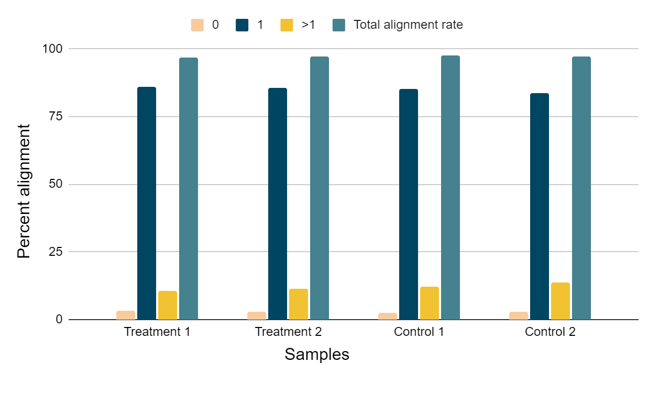
Alignment
HISAT2 was used to align the reads to the reference genome before peak calling of all the samples.
GRCh38 was used as a reference genome for alignment of the reads using seed-and-extend algorithm
Fig: Percentage alignment for Treatment and Control group reads with the reference genome
Notes:
Post trimming the reads were aligned to the reference genome GR chromosome 38, where the alignment was achieved using seed-and extend algorithm. The following plot shows the total alignment for all the sample. A consensus of more than 97% of the reads aligning to the reference genome is shown in the plot, with significant percentage of reads aligning once to the reference genome.

Slide 10
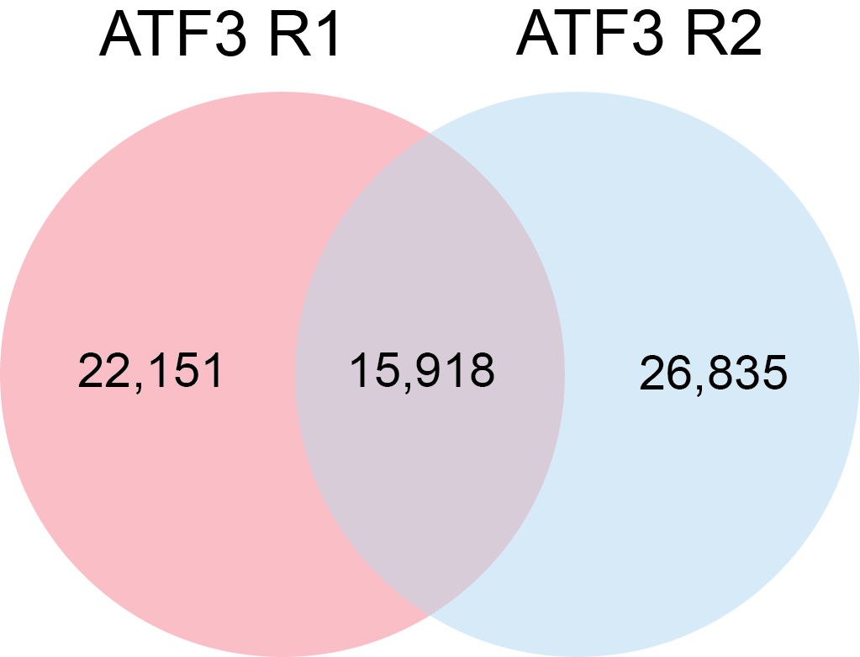
Peak calling
Peak calling: MACS2 callpeak
Consensus peaks: BEDtools intersect
Notes:
Narrow peaks
Used macs2 because it can capture background noise for more accurate identification of true signal peaks by distinguishing them from noise

Slide 11
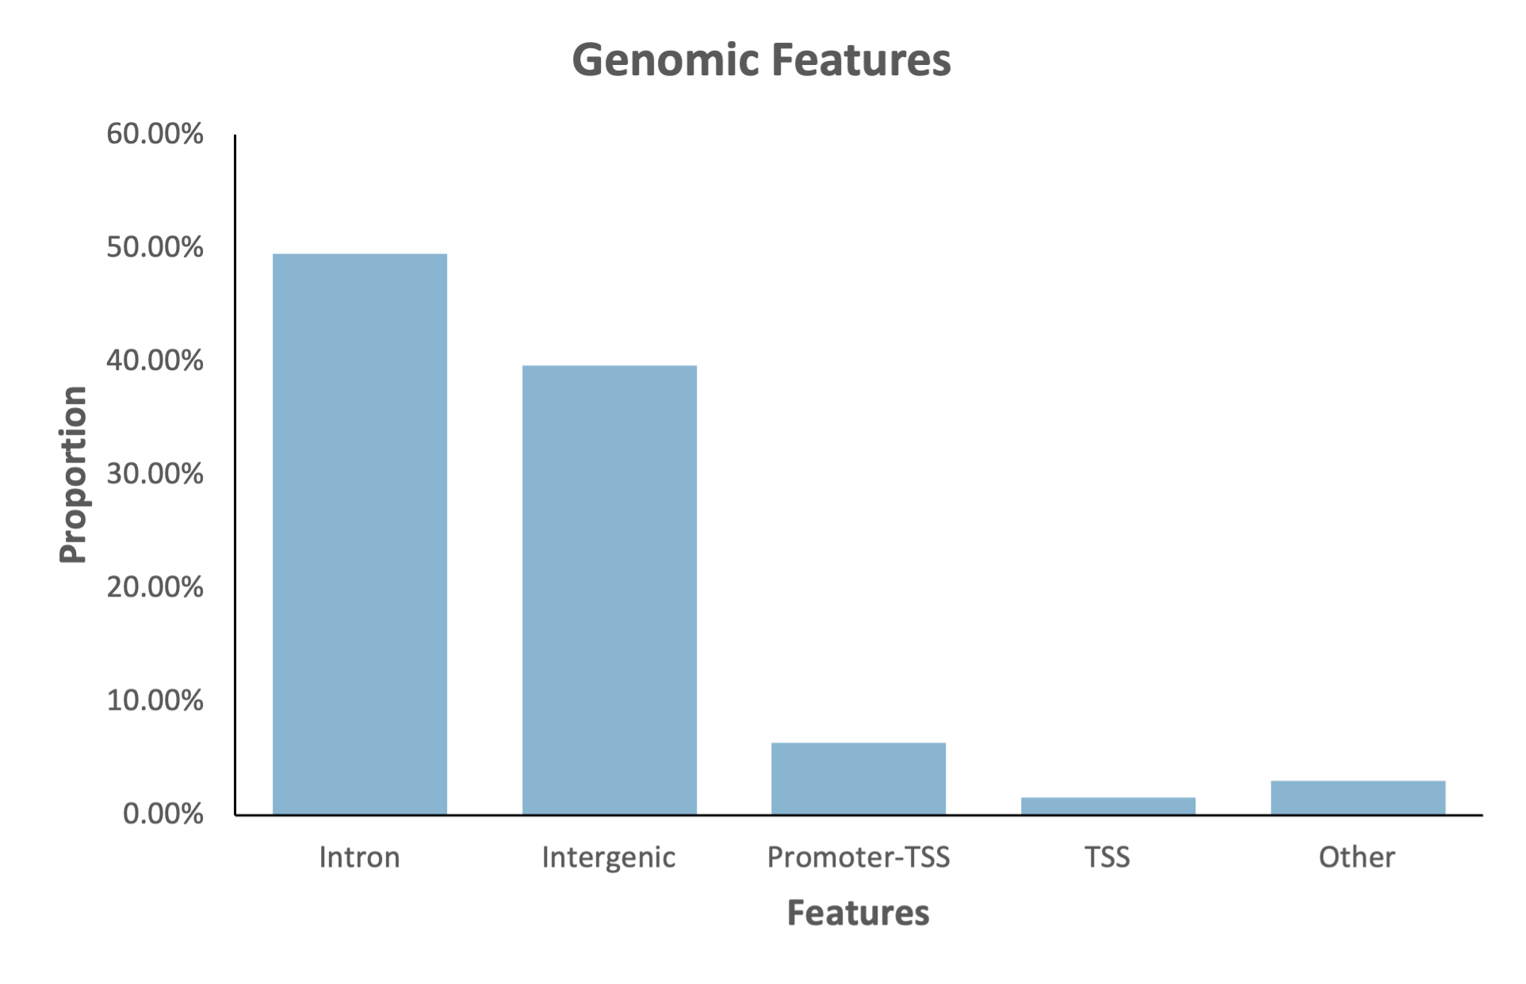
Annotate Peaks: Genomic Features
Other:
3’ UTR
Exon
Noncoding
5’ UTR
Notes:
We were able to annotate the peaks using the Homer software.
This provides information about the what genomic region the AFT3 is binding to. This shows that the peak overlaps with intron, intergenic and promoter-TSS mainly.
**Promoter transcription start site

Slide 12
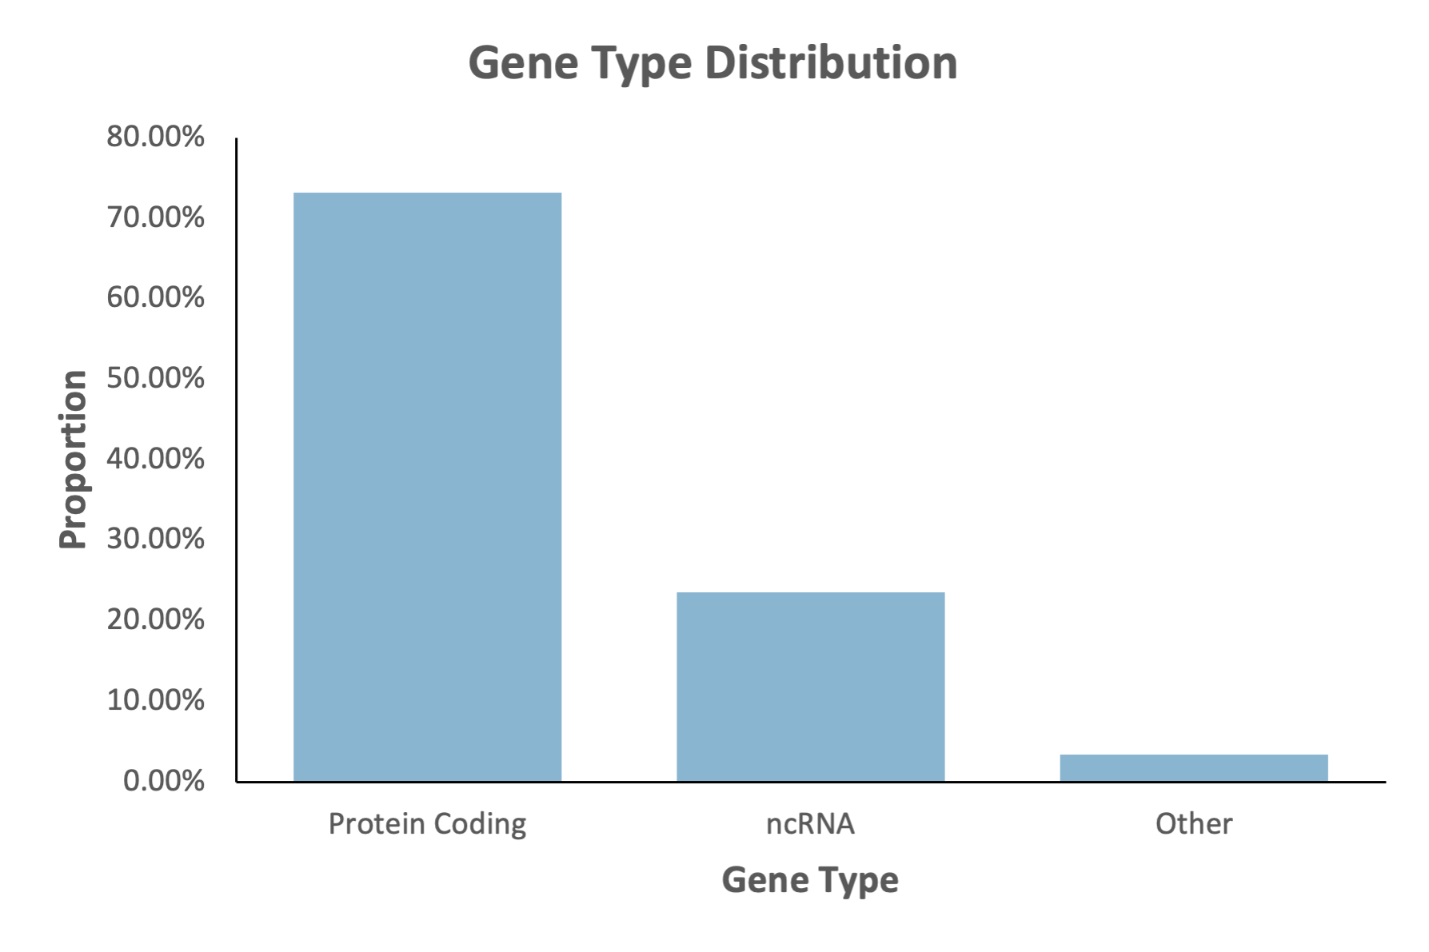
Annotate Peaks: Gene Types
Other:
Pseudo
snoRNA
snRNA
scRNA
rRNA
Notes:
We also annotated the peaks to specify the type of genes associated with the peaks
In our analysis, the majority of genes associated with ATF3 are protein-coding genes.

Slide 13
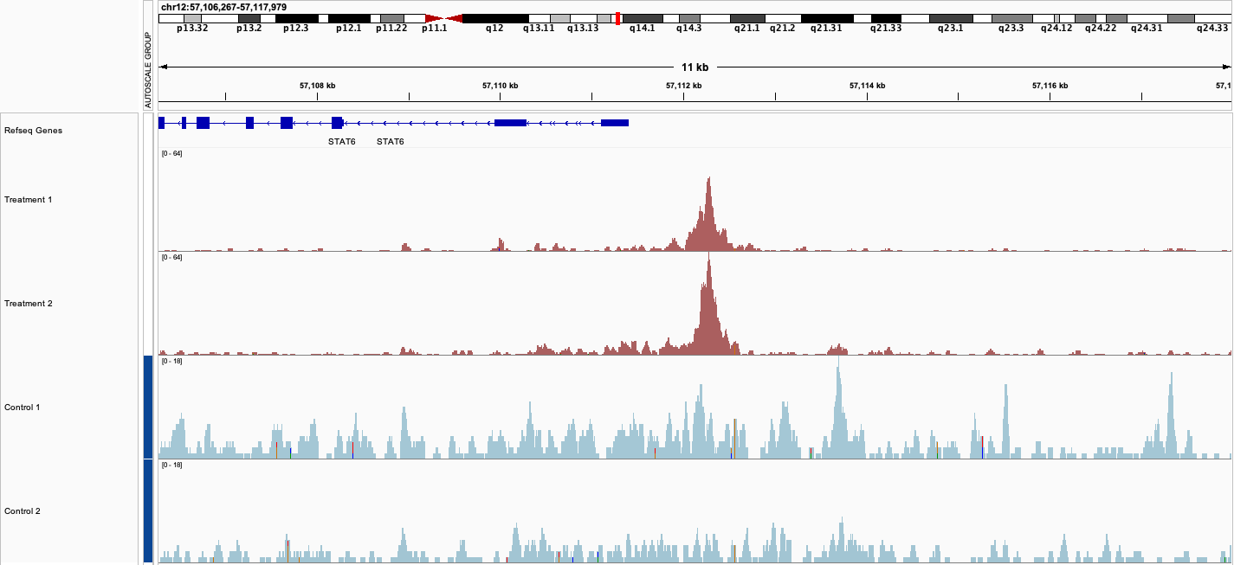
Visualizing Peaks: STAT6
Is highly expressed in HCC
Notes:
ATF3 is promoting the expression of STAT6
STAT6 is a gene that is highly expressed in various human cancers, including hepatocellular carcinoma, and is associated with poor prognosis in HCC patients.
It’s been reported that ATF3 can modulate STAT signaling pathways by either enhancing or suppressing their activity, depending on the context and cellular environment. And in doing so, ATF3 plays critical roles in various cellular processes, including inflammation, immune responses, and cancer progression.

Slide 14
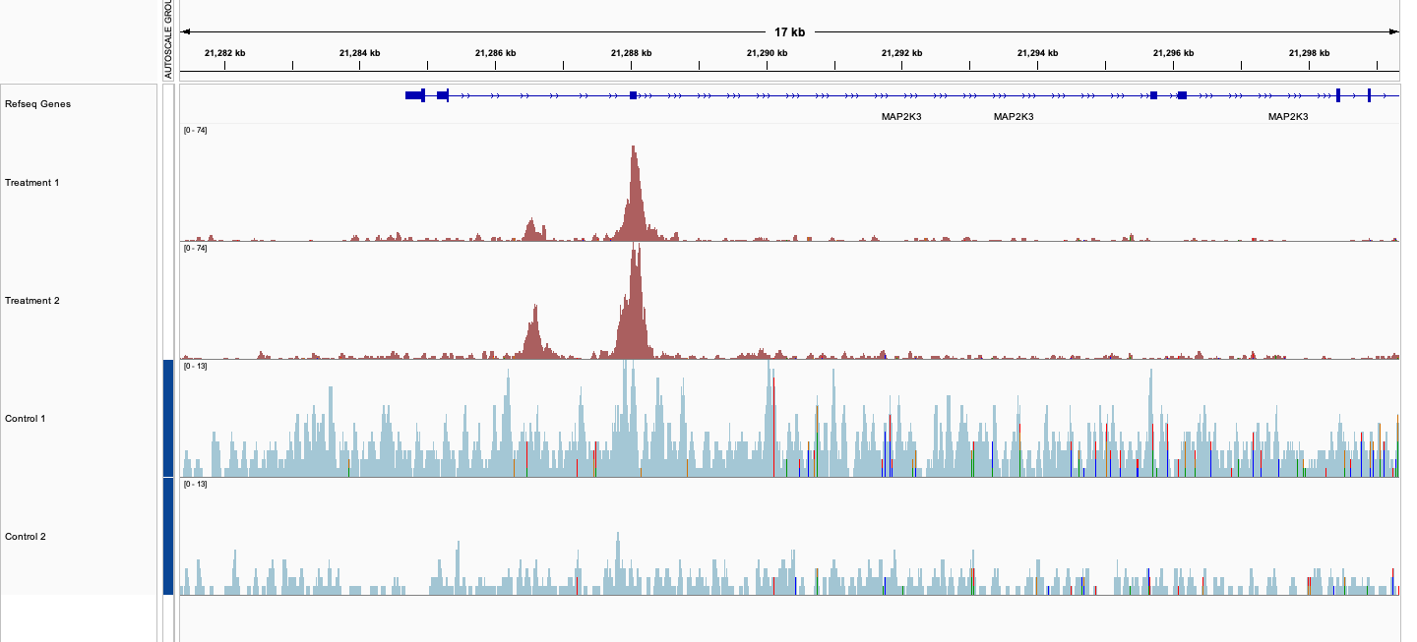
Visualizing Peaks: MAP2K3
Notes:
miR-21-mediated repression of MAP2K3 contributes to the proliferation of HCC cells, highlighting the potential significance of targeting this miRNA-MAP2K3 axis for therapeutic intervention in HCC.
MAP3K3 kinase is activated by mitogenic (substances that stimulate cell division) and environmental stress and is necessary for the expression of glucose transporter.
Activation of MAPK14 and confers abnormal cell division which can play a role in the proliferation of cancer
MAP2K3 is usually reported to play a role in cardiovascular diseases.
In our data, it was interesting to see that the ATF3 could potentially be promoting the expression with this gene since this hasn’t been reported in literature and it could be of interest.

Slide 15
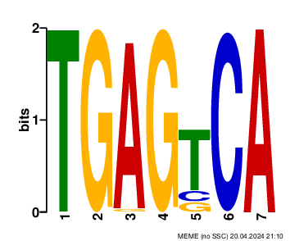
Motif Discovery
Site Count: 5043
31.68%
Validated through Zhao et al., where they noticed the top 12 motifs contained the AP-1 sequence TGAGTCA.
Notes:
For MOTIF discovery we used MEME Suite Tool which allows us to know the binding site for ATF3.
The site count is 5,043 which represents the amount of times the motif shows up
The percentage tells how many ATF3 proteins in our sample is binding to the motif sequence which was calculated by taking the site count and dividing it by the number of ATF3 peaks that overlapped
The motif was validated through Zhao et al where they noticed the top 12 motifs contained the AP-1 sequence TGAGTCA. This suggests that ATF3 may bind to DNA sequences containing the AP-1 motif, which is consistent with its known ability to form heterodimers with other proteins, including those in the AP-1 complex

Slide 16
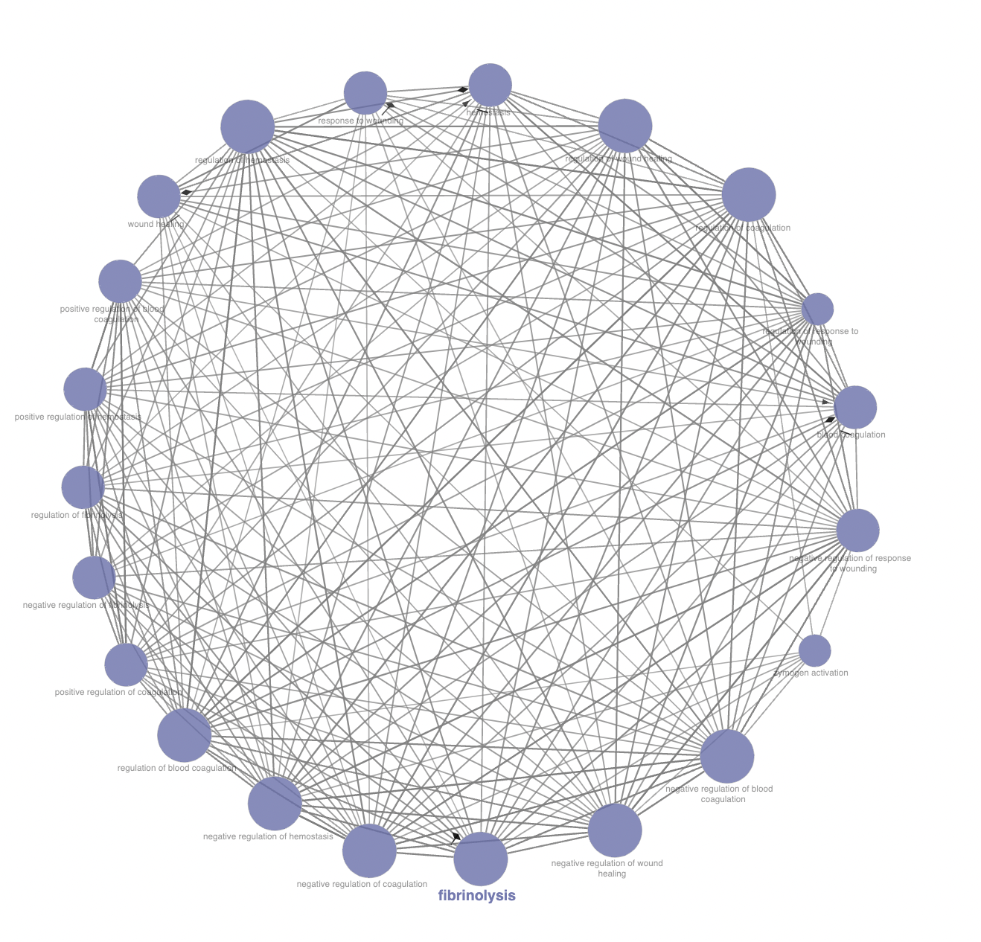
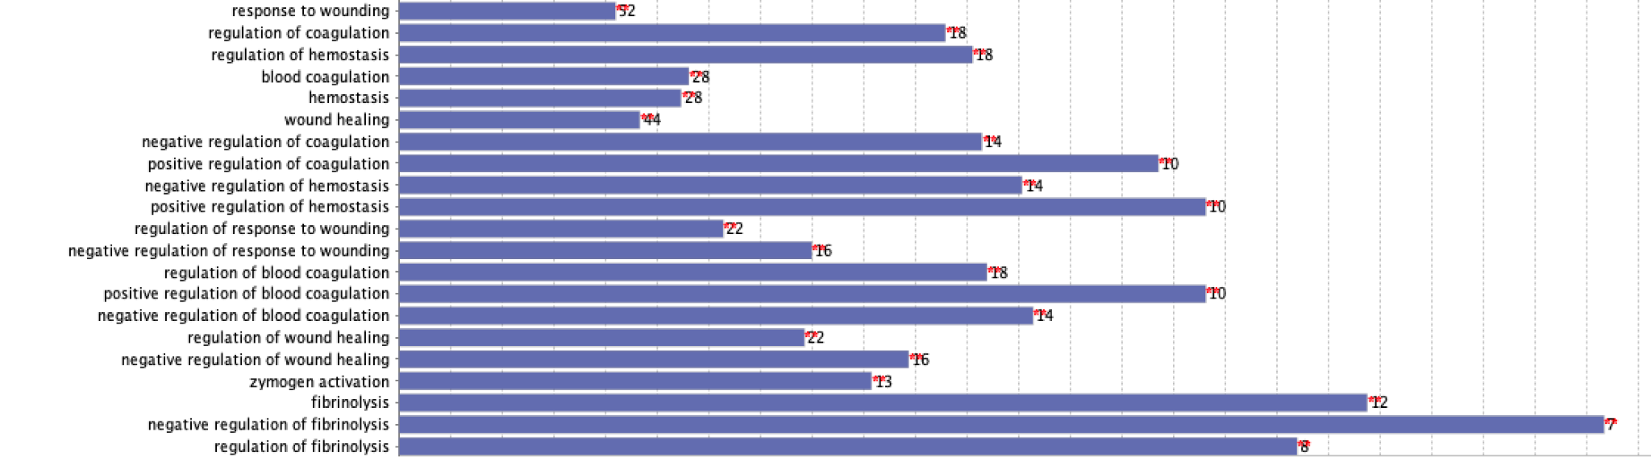
Functional Enrichment
Notes:
We then performed functional enrichment analysis in Cytoscape using ClueGo
We first had to filter the genes in our annotation file to genes that were promoter transcription start sites to see what pathways were enriched. We were able to identify 183 unique GO terms and I am going to discuss the two pathways we thought were interesting.
What is fibrinolysis and how ATF3 plays a role
Fibrinolysis is the degradation of fibrin which is a protein that forms the structure of a blood clots. In HCC cancer cells can stimulate fibrinolysis which can facilitate tumor invasion and metastasis. ATF3 can play a role in this pathway due to its indirect influence on fibrinolytic pathways through its regulatory effects on gene expression

Slide 17
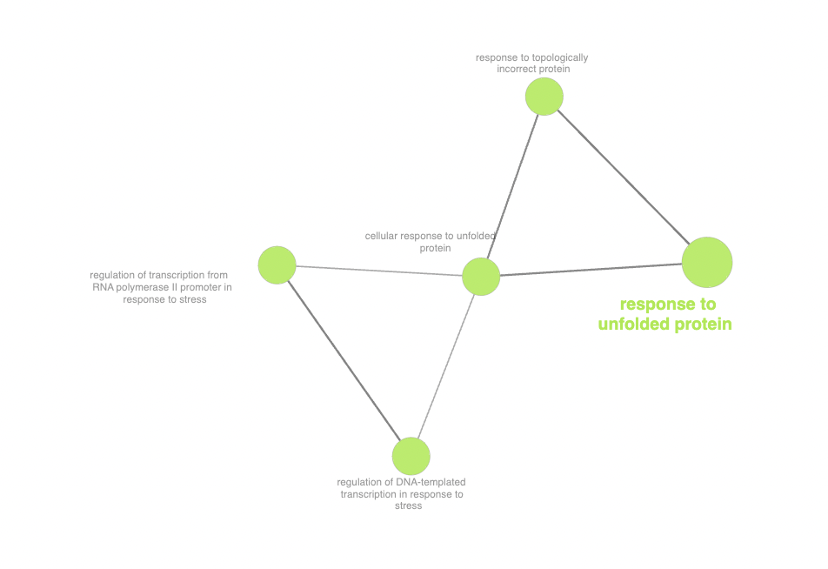
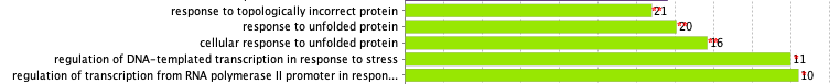
Functional Enrichment
Notes:
Another enriched pathway we discovered was the response to unfolded protein which are common in HCC due to factors such as viral infections, hypoxia, and metabolic dysregulation. ATF3 is involved in the unfolded protein response (UPR), a cellular pathway activated in response to ER stress, suggesting its potential role in HCC pathogenesis.

Slide 18
Conclusion

Slide 19
Conclusion
RT-qPCR to validate the expression changes of genes upon ATF3 modulation
ChIP-qPCR to validate the direct binding between ATF3 and the genes of interest
Key Takeaways:
Explored ATF3’s role in modulating liver cancer-related pathways through genome interactions.
Uncovered novel gene interactions, offering fresh research avenues.
Offers potential for further investigation into ATF3's impact on gene regulation.
Notes:
Learned about the enriched pathways in ATF3 and how they relate to HCC
RT-qPCR (Reverse Transcription Quantitative Polymerase Chain Reaction):
This technique can confirm changes in mRNA expression levels of STAT6 upon ATF3 modulation. By comparing ATF3-overexpressing or ATF3-knockdown cells to control cells, one can assess whether alterations in ATF3 levels lead to corresponding changes in STAT6 mRNA levels.
provides a targeted and quantitative assessment of protein-DNA interactions, enhancing the confidence in the identified binding sites and the conclusions drawn from the ChIP-seq analysis.
ChIP-qPCR can validate the interaction between ATF3 and the STAT6 promoter region identified in the ChIP-seq experiment. By immunoprecipitating ATF3-bound chromatin fragments followed by qPCR targeting the STAT6 promoter region, one can confirm the direct binding of ATF3 to the STAT6 promoter.

